Slide 1
C.4 Virus Presentation – Apr 17
Agenda
Discussion
Trump – Kim / USB Fans
Slides C.4 Virus Presentation
Choose your topic
Complete Research / Begin Slides (Today)
Present (Tomorrow - Tuesday)
Upcoming
Complete for Homework : Case Study C.3 Ransomware

Slide 2
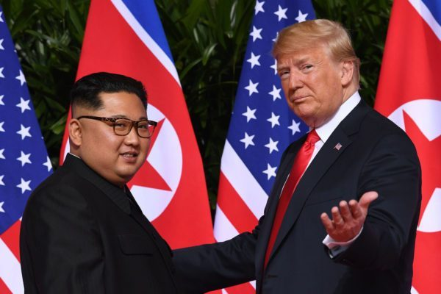
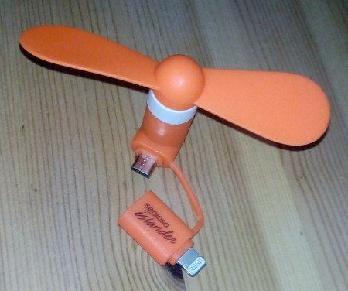
Trump - Kim Summit
Meeting – Singapore, June 2018
Security Issue
USB Fans were given out (for free) to people in attendance
The fans were provided by host nation China
Security Concern
The USB Fans were suspected to contain Malware
Further analysis revealed that there were no issues

Slide 3
NamPhoHyu
https://www.bleepingcomputer.com/news/security/nampohyu-virus-ransomware-targets-remote-samba-servers/

